Slide 1
fybrrLink: Efficient QoS-aware routing in SDN enabled Space Architecture​
Debajyoti Halder - Prashant Kumar - Saksham Bhushan

Slide 2
Abstract
Demand for seamless anywhere anytime communication is increasing
Satellite networks must be used as a service.
Traditional IP-based architecture is unable to meet the current requirements.
A variety of applications has diverse Quality of Service(QoS) requirements.
Current satellite architecture doesn’t take these requirements into the account.
We are proposing a novel and centralized QoS-aware routing algorithm for SDN enabled space network
Further, fybrrLink is evaluated with multiple NS3 simulations...

Slide 3
Introduction
Terrestrial network is not enough.
Advantages of Software Defined Network(SDN)
Using SDN for non-terrestrial architecture
Variety of applications have diverse QoS requirements.
Notes:
FCC filings

Slide 4
Contributions
Extension of SDN to non-terrestrial network.
Efficient QoS aware routing algorithm for space network-ing which computes better routes in much lesser time than the algorithms of other schemes.
Avoidance of congested links during routing
Quick rerouting during ISL congestion or satellite failure.
Flow rule transfers for non-disruptive service during satellite handovers

Slide 5
Related Works
Shortcoming of traditional satellite network
Multiple SDN based architectures are being proposed
Software-Defined Next-Generation Satellite Networks:
STIN
SAGECELL
Ant colony optimization
Software-defined routing algorithm (SDRA) for NTN
Software-defined space networking (SDSN)
Well researched problem for terrestrial networks…..

Slide 6
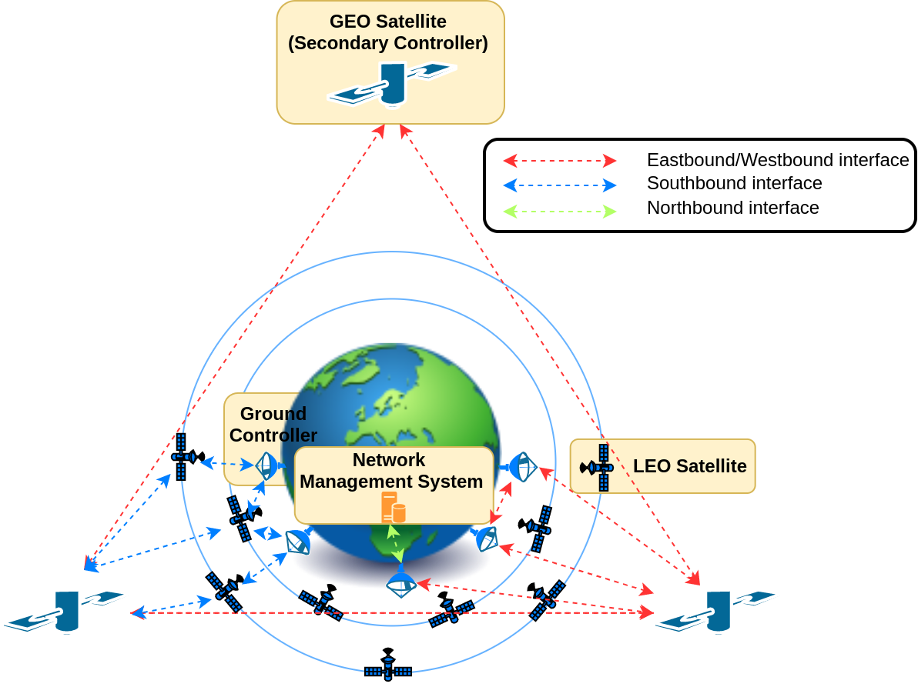
System Model

Slide 7
3 Modules
Topology discovery and monitoring
To construct topology and monitor the link parameters
Flow rule transfer
To Hande topology alteration problems
QoS aware routing :
To calculate the most optimal path for a flow

Slide 8
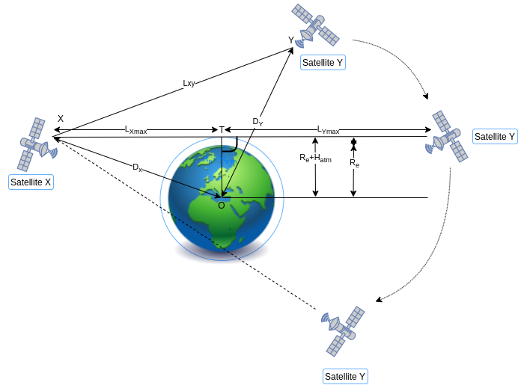
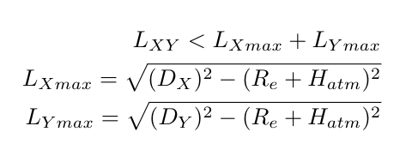
Visibility of satellites

Slide 9
Communication Links and Cost Calculation
Intra-Orbit Links
Inter-Orbit Links
A flow can have the following QoS parameters along with source and dest.
Minimum required bandwidth B
Maximum end to end delay D
Maximum jitter J
Maximum packet loss ratio PLR
The fitness score of each edge can be defined as
Score= k1*AB + k2/latency + k3*(1- PLR) + k4/Jitter + k5*StabilityFlag
Further, Cost of the link between vertex i and vertex j is
Cost[i,j] = 1/Score[i,j]

Slide 10
Link Parameters….
B[i,j] represents the bandwidth (capacity) of link_{i,j}
CD[i,j] is the congestion degree
CD[i,j] = Load[i,j]/B[i,j]
D[i,j] is the delay associated with the link_{i,j}
PLR[i,j] is the packet loss ratio of the link_{i,j}
PLR[i,j] = (PacketTransmitted[i,j]-PacketReceived[i,j])/PacketTransmitted[i,j]
AB[i,j] represents the available bandwidth of the link
If Congested link if Load[i,j] is more than the 80% of B[i,j] or CD[i,j] > 0.8:
Put AB[i,j] = 0
Else:
AB[i,j] = B[i,j] - Load[i,j]
J[i,j] is the average jitter associated with the link[i,j]
J[i,j] = 1/(t-startTime)*∑(|Latency[i,j][t(i)] - Latency[i][j][t(i+1)])... For startTime < i < t
Stability Flag[i,j] = 1 if it is a intraorbit link and 0 otherwise

Slide 11
Proposed Approach
fybrrLink

Slide 12
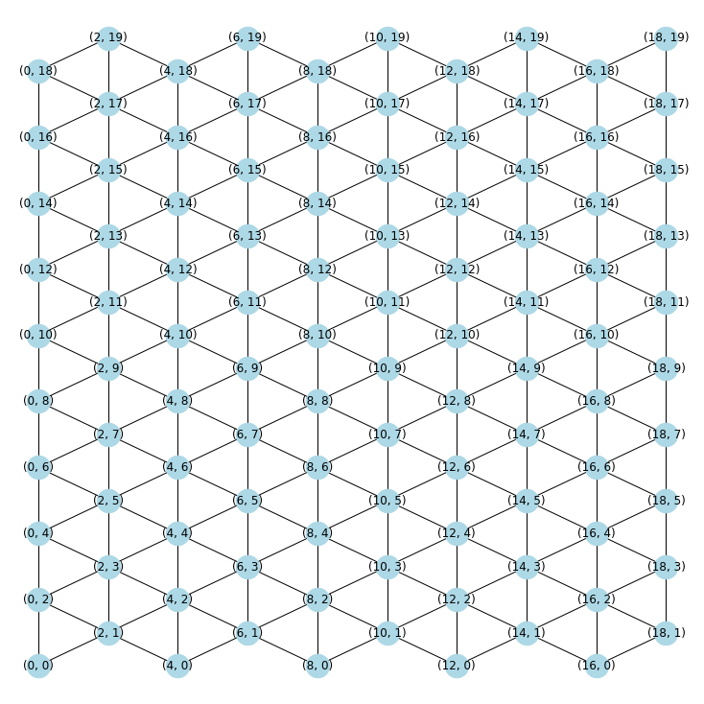
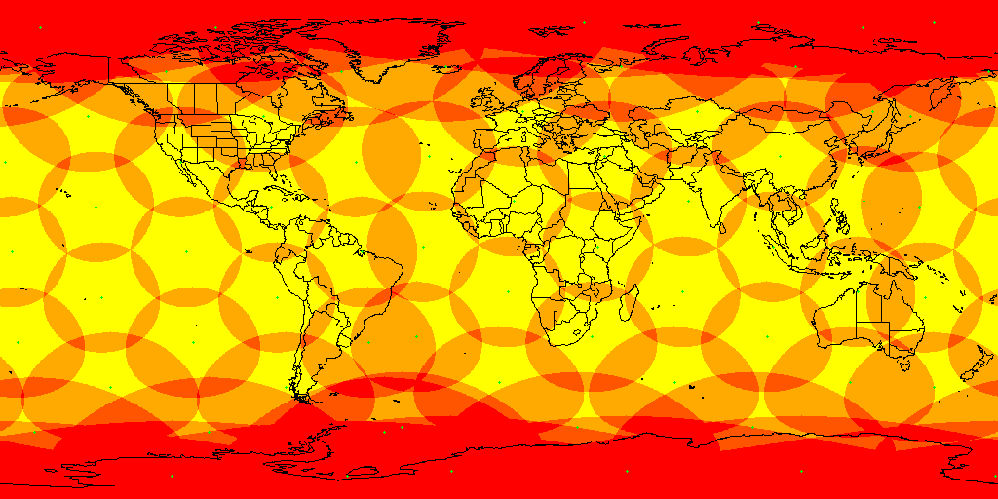
Assumptions
Iridium-like satellite constellation - pole to pole orbit
Satellites are connected in two different ISL types with total 6 ISLs
2 Vertical ISLs
4 Diagonal ISLs
All satellite orbits are at same altitude from sea level

Slide 13

Bresenham’s Line Algorithm
Determines points of an n-dimensional raster to be selected in order to form a close approximation to a straight line between two points.

Slide 14
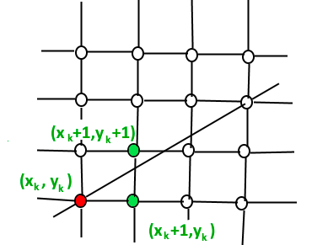
Routing using Bresenham’s Line Algorithm

Slide 15
Routing using Bresenham’s Line Algorithm

Slide 16
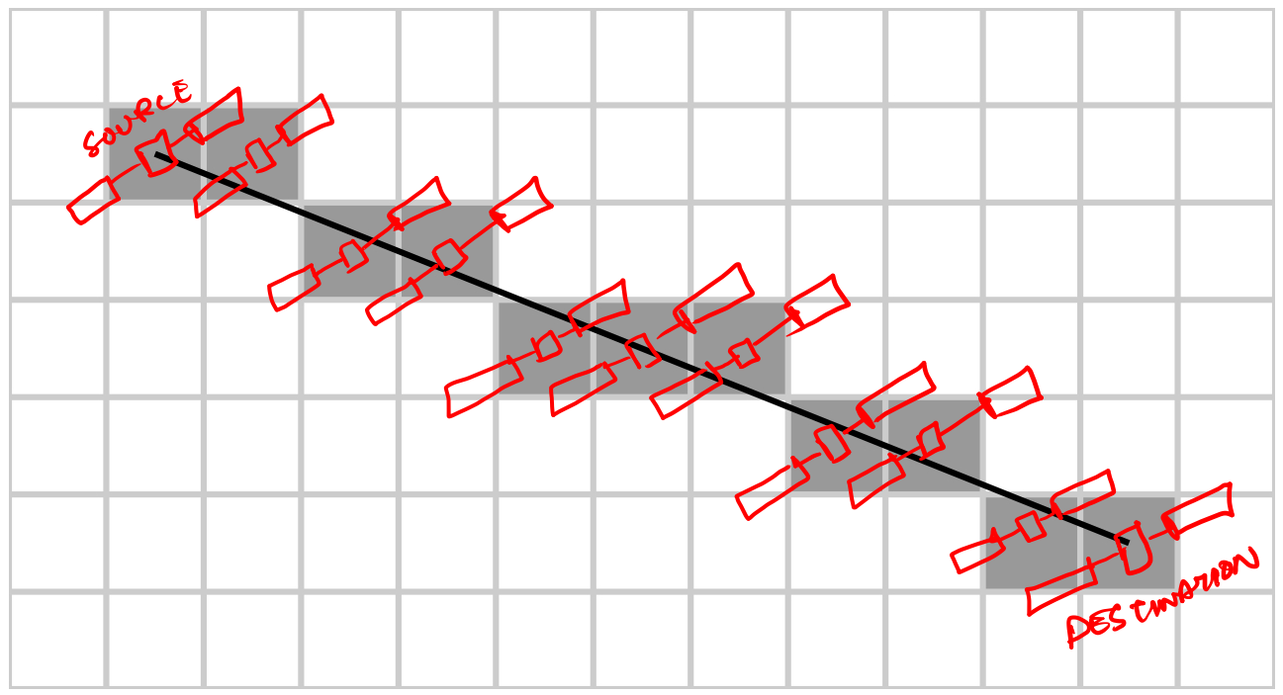
Routing using Bresenham’s Line Algorithm

Slide 17
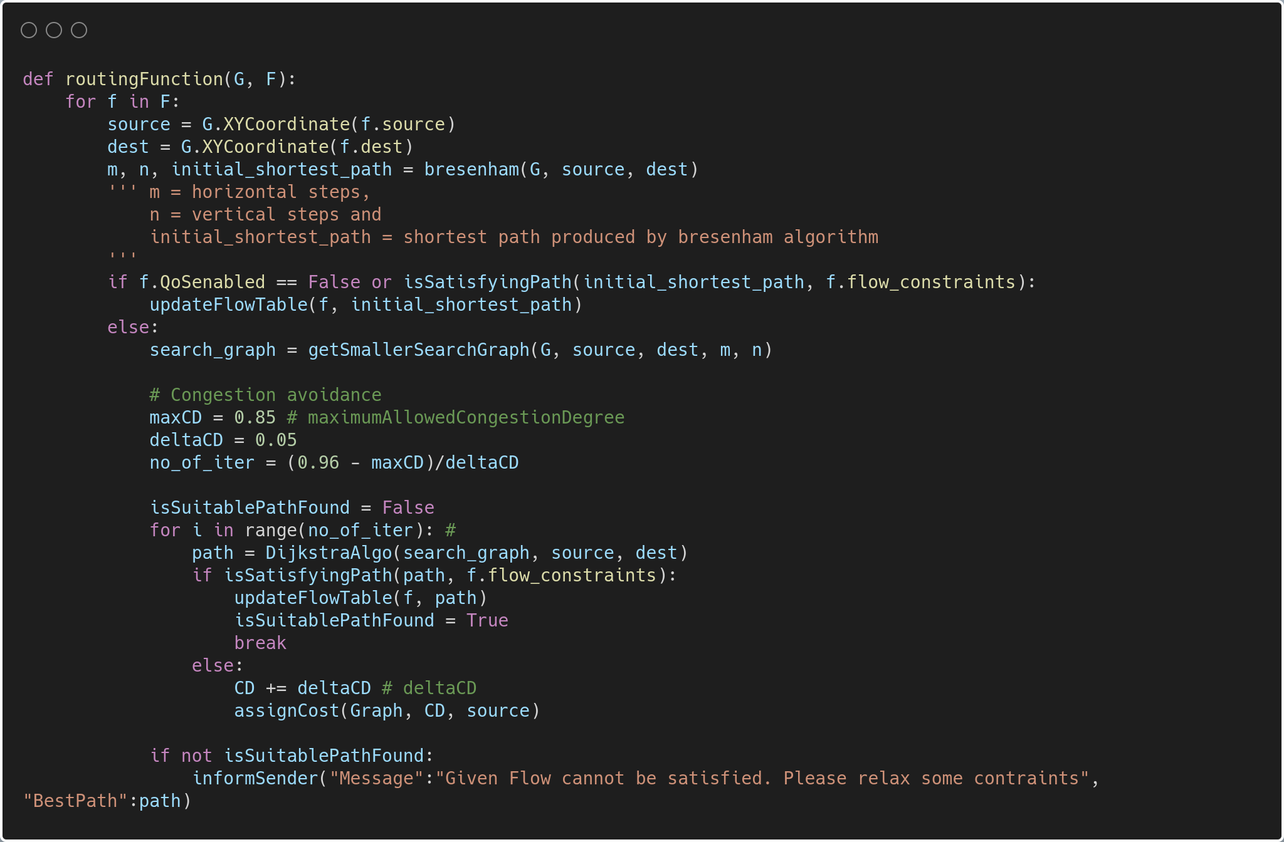
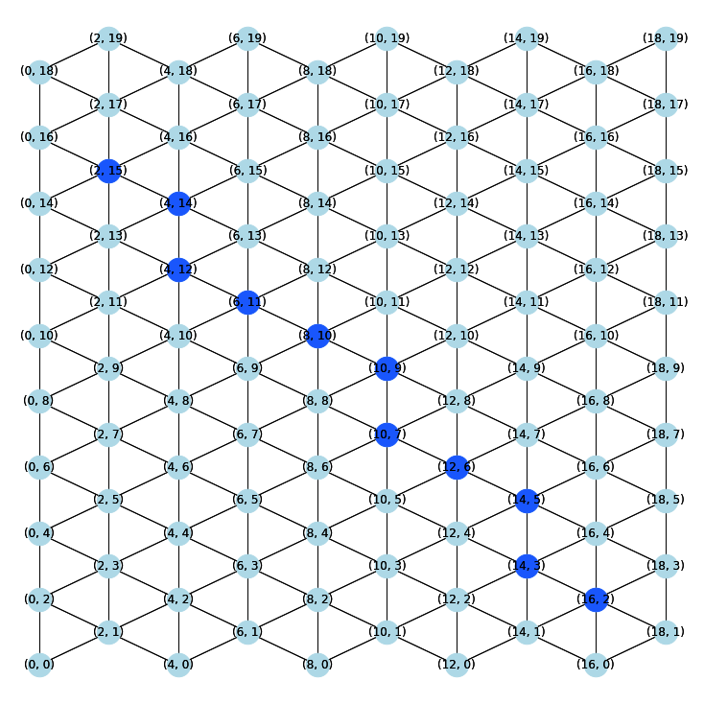
Modified Bresenham’s Routing Algorithm

Slide 18
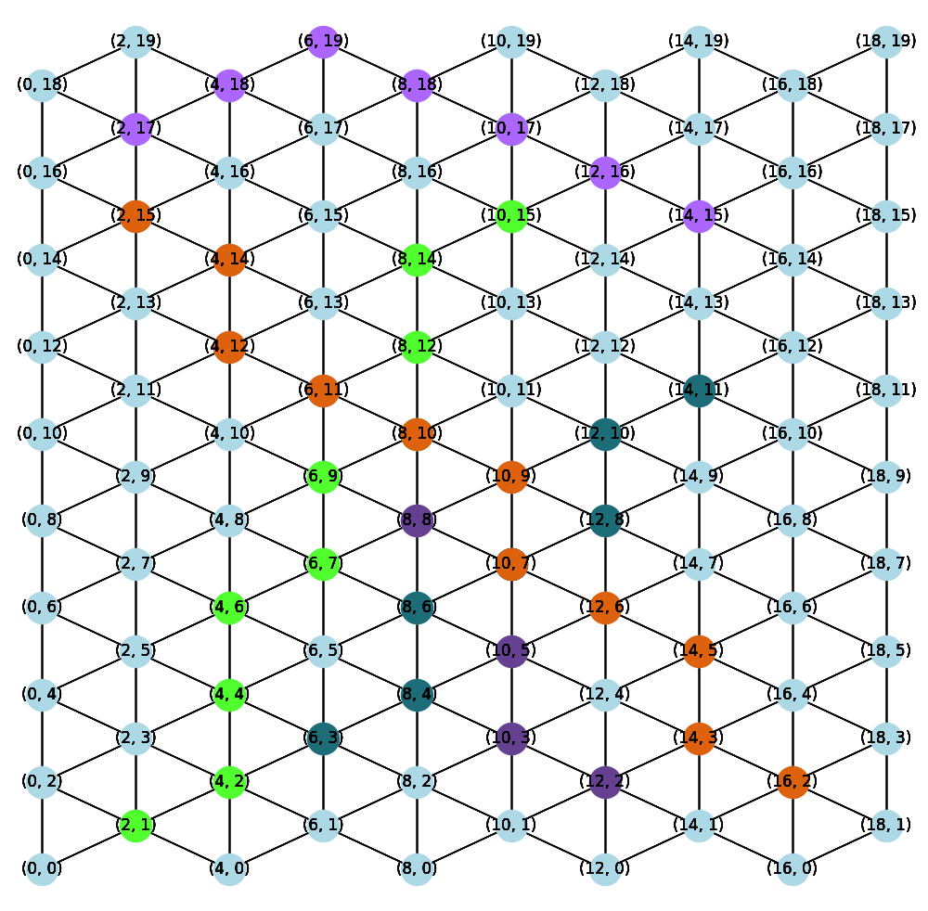
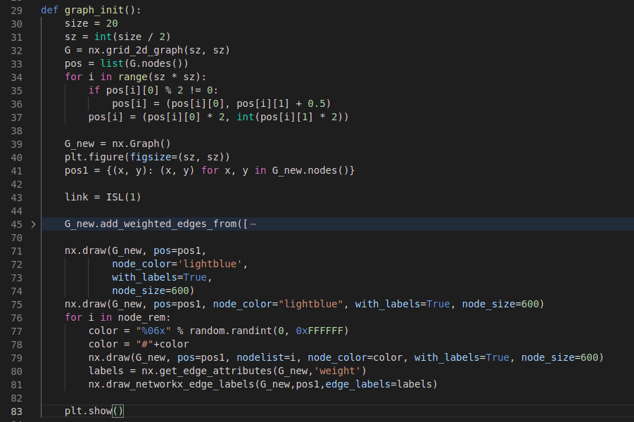
NetworkX - Used for visualization of the algorithms

Slide 19
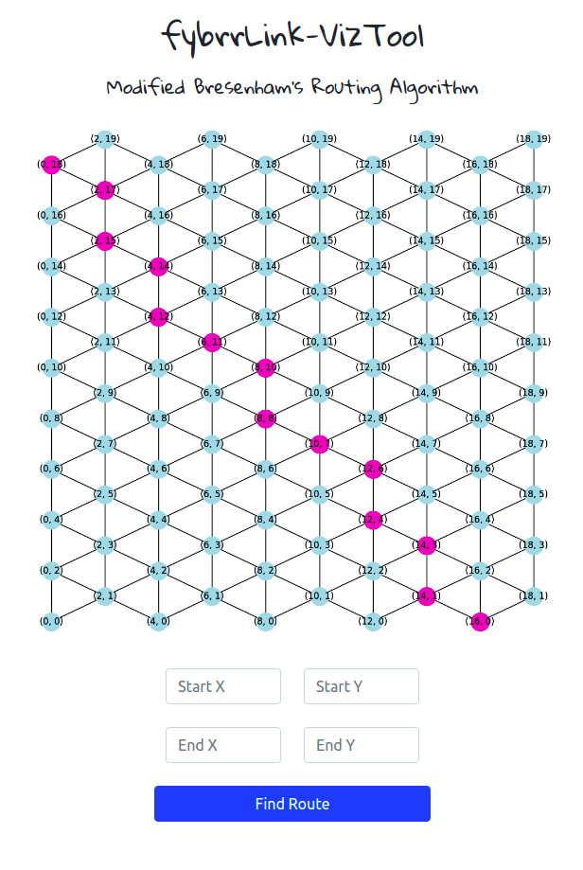
fybrrLink-VizTool
Implementation of the modified bresenham algorithm is available as a web tool.
Link : https://fybrrlink-viztool.herokuapp.com

Slide 20
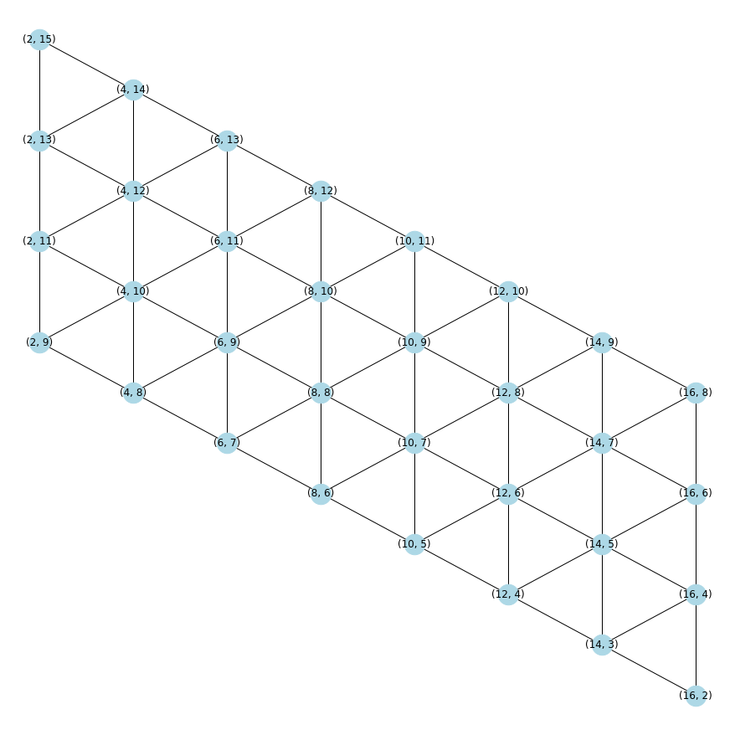
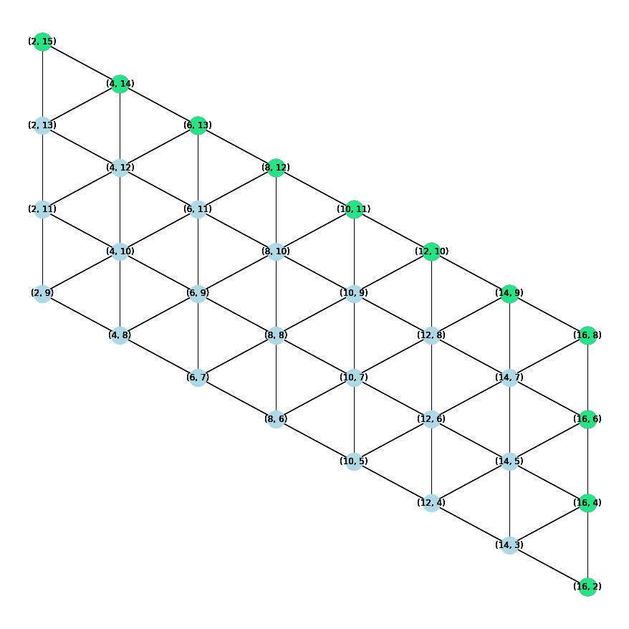
Flow of the fybrrLink Algorithm

Slide 21
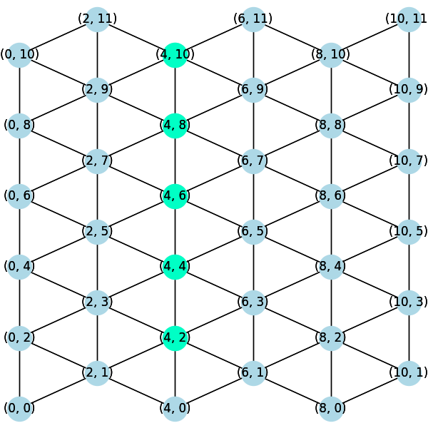
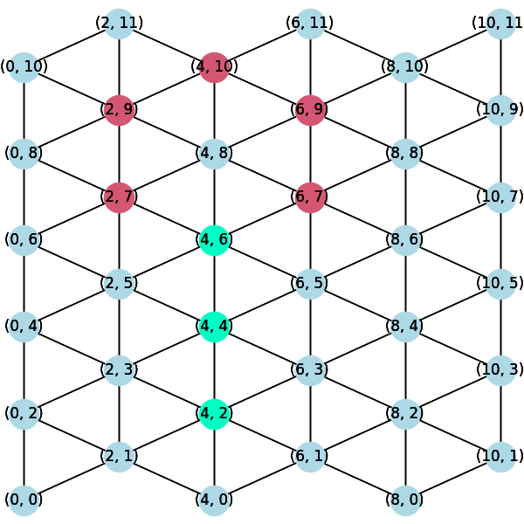
Edge Cases
Direct Vertical Path
The shortest path between source and destination satellites comprises vertical ISLs only.
Cannot form Ideal Parallelogram
Deviate path during congestion and run routing algorithm to find route from possible intermediate satellites.
No congestion
After congestion

Slide 22
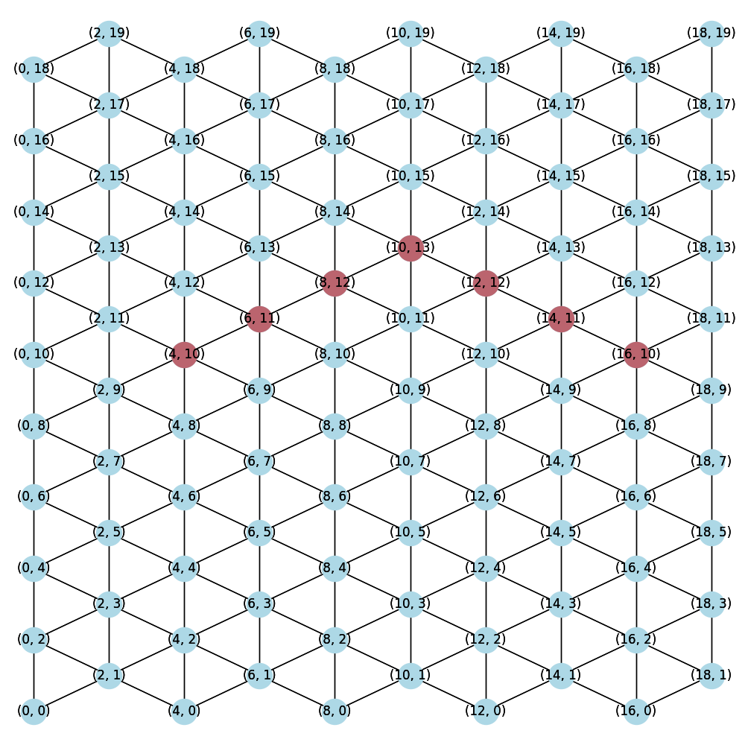
Edge Cases
Only Diagonal ISLs Path
The shortest path between source and destination satellites comprises diagonal ISLs only.
Ideal Parallelogram can be formed with mirrored links

Slide 23
Complexity Analysis
Time Complexity
Dijkstra - O(V + ElogV)
Bresenham - O(N)
N = m + n
m → vertical ISLs
n → diagonal ISLs
fybrrLink - O(N) + O(V’ + E’logV’)
V’ → (m + 1)(n + 1)
E’ → (m + 1)n + (n + 1)m

Slide 24
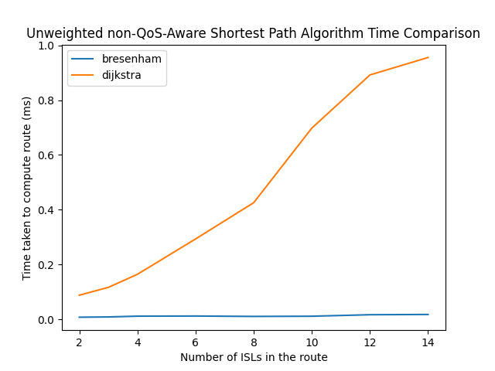
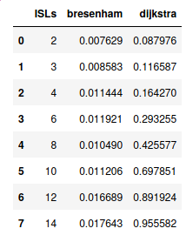
Complexity Analysis

Slide 25
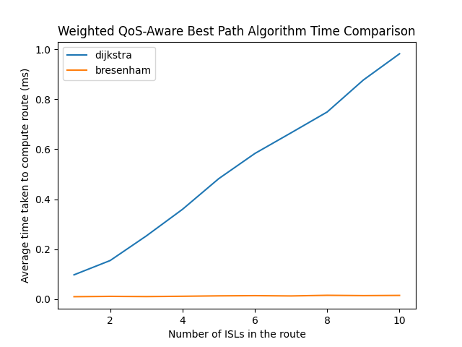
Complexity Analysis

Slide 26
Performance Evaluation

Slide 27
What we have implemented?
Modified bresenham algorithm
Conversion of satellite coordinates to 2d coordinates
Graph implementation of satellite network
Implementation of the function getIdealParallelogram()
Implementation of the function getEdgeCost()

Slide 28
Performance Metrics
Average execution time
Packet Loss rate
Average Latency/End-to-end Delay
Congestion degree
Satisfaction Ratio

Slide 29
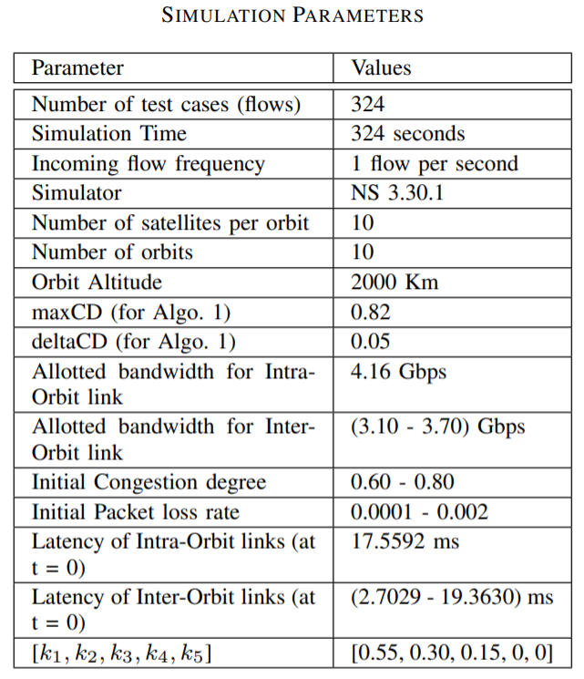
Experimental Setup
Flow control Simulation - NS3 Network Simulator.
Routing Algorithm Simulation - Networkx on Python.

Slide 30

Schemes to compare
Dijkstra Algorithm
The most popular shortest path finding algorithm.
Compared with almost every NTN based routing proposals.

Slide 31
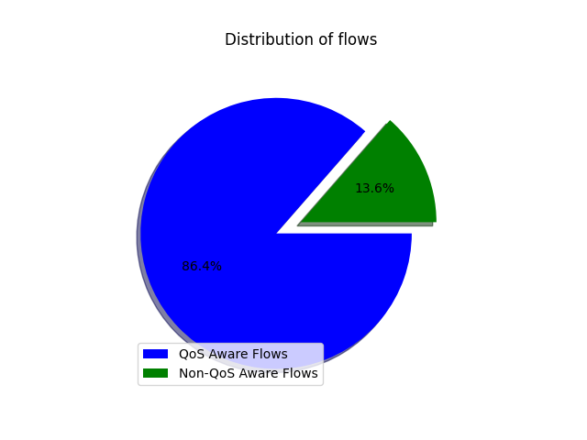
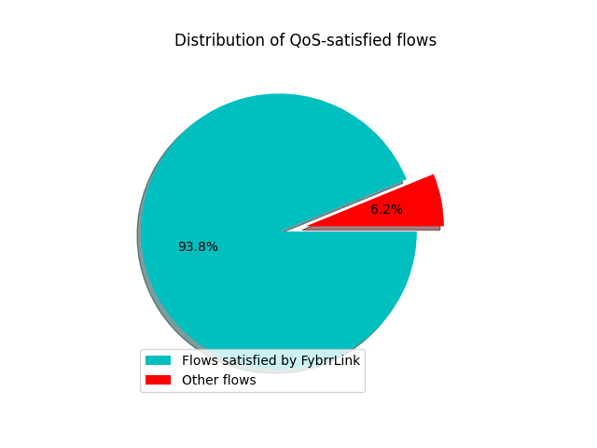
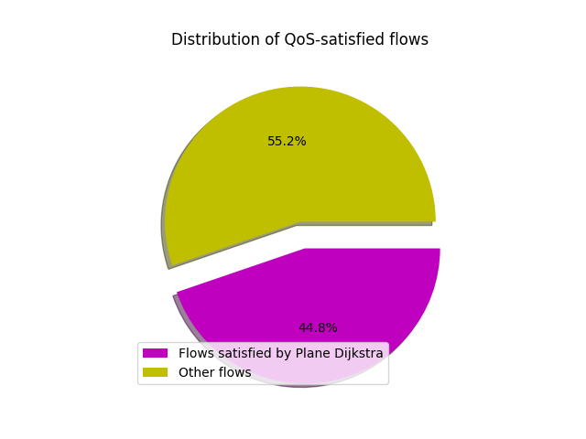
QoS-aware flow distributions

Slide 32
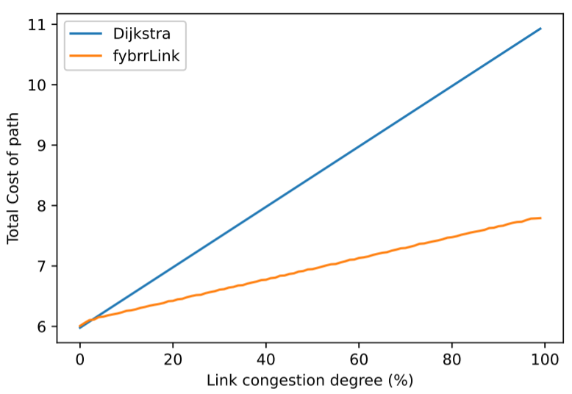
Congestion Degree analysis
Cost of path with increasing link congestion degree.
fybrrLink performs 27% better than Dijkstra.

Slide 33
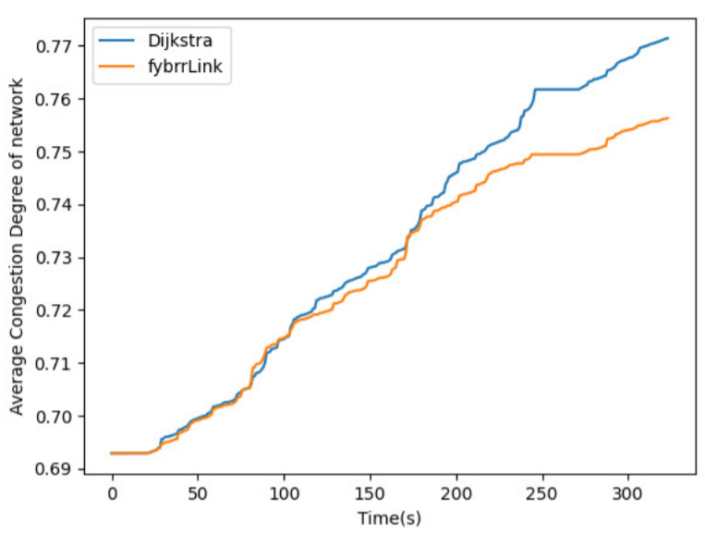
Variation of Average CD with time
Congestion degree trend with incoming packets with rate 1 per sec.
fybrrLink performs better than Dijkstra.

Slide 34
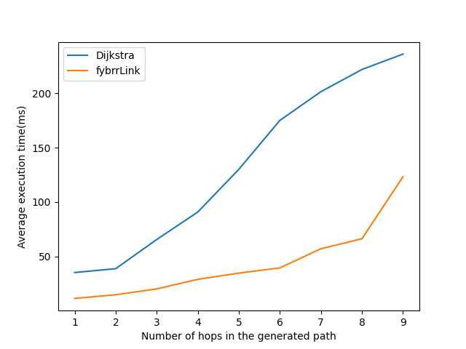
Average Execution time vs #hops in path
Time taken for computing path with increasing search space.

Slide 35
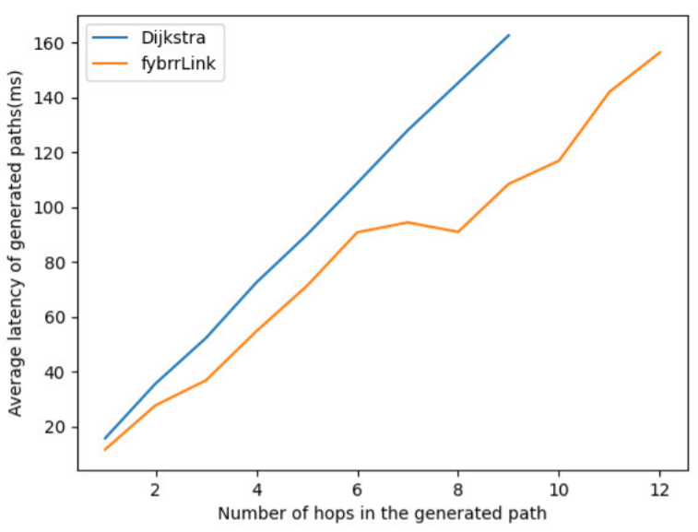
Average latency of paths vs #hops in path
fybrrLink finds path with lower latency than Dijkstra.
For 8 hops, fybrrLink performs 38% better than Dijkstra.

Slide 36
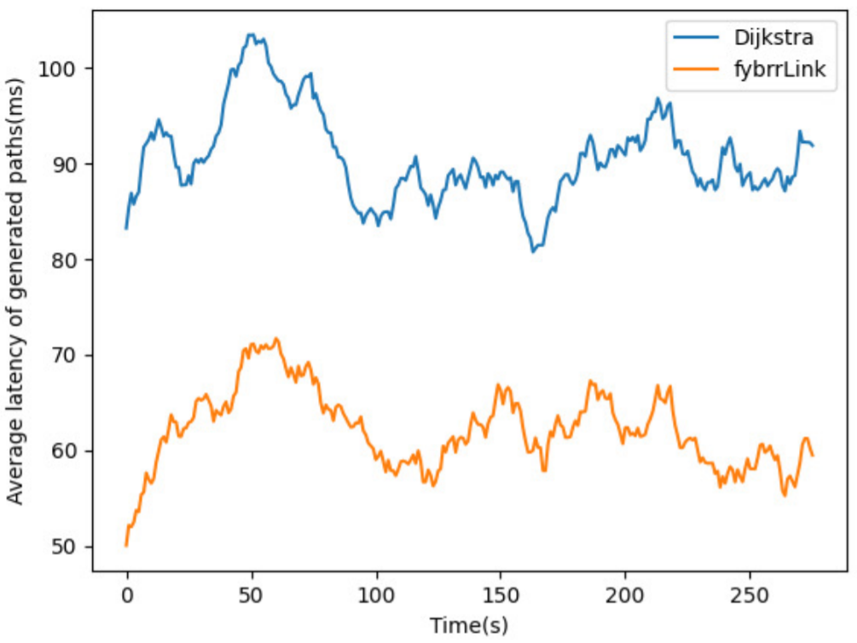
Variation of average latency of paths (moving average) with time.
Moving average of window 50 for simulation duration.
Clearly, fybrrLink is able to find paths with lower latency for all test flows.

Slide 37
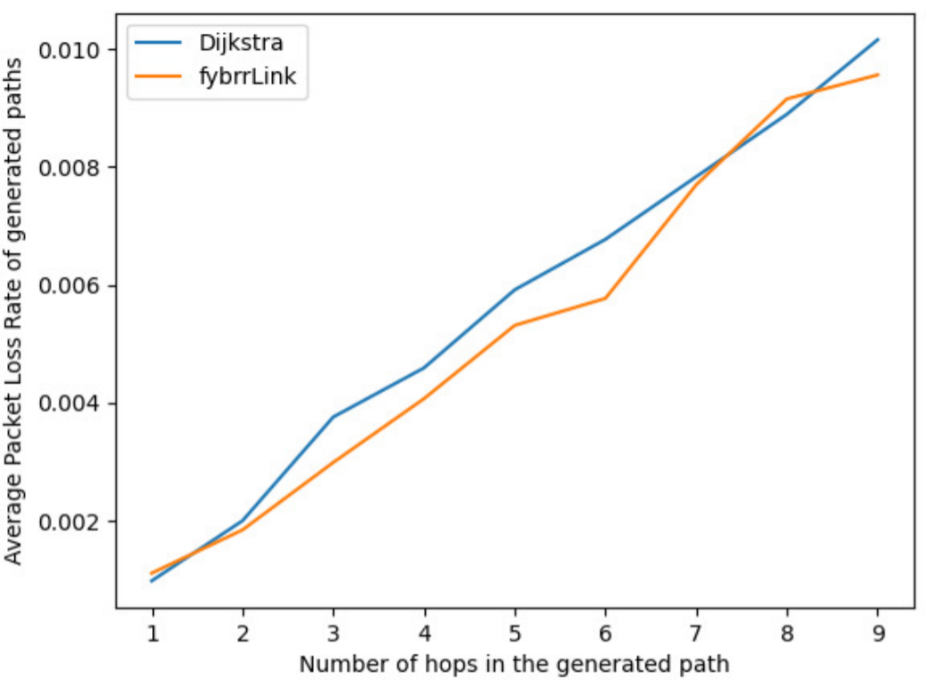
Average PLR of paths vs #hops in path
Increasing PLR with increasing hops.
fybrrLink performs slightly better than Dijkstra.

Slide 38
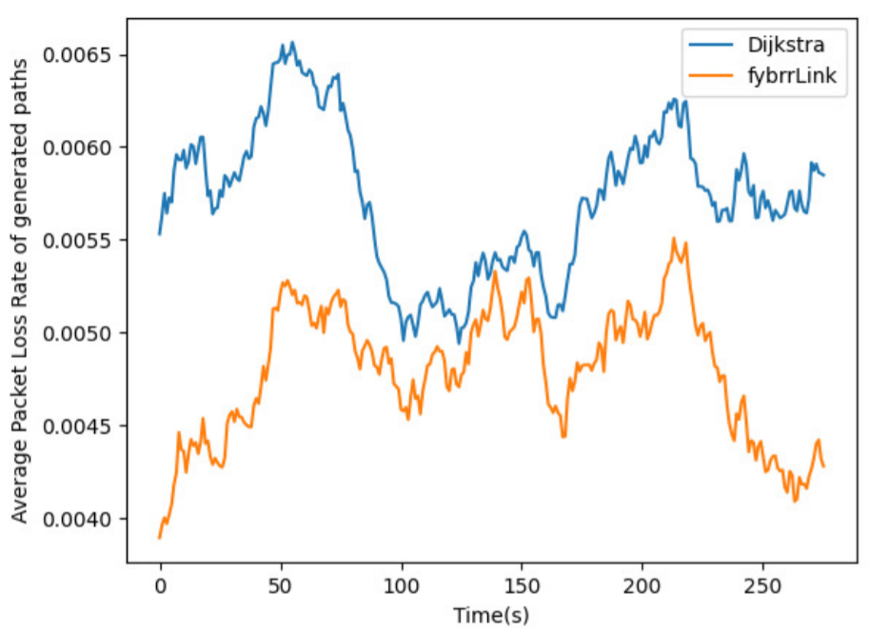
Variation of average PLR of paths (moving average) with time.
Moving average of window 50 for simulation duration.
Clearly, fybrrLink is able to find paths with slight lower PLR for all test flows.

Slide 39
Conclusion
Proposed QoS-aware routing algorithm using the global knowledge from SDN in Non-Terrestrial Networks.
Proposed 6 ISL link model for more efficient routing.
Simulations on NS3 provides credibility to the comparison.
Robust evaluation and comparison of our approach with Dijkstra proves fybrrLink to be better.

Slide 40
Future Works
Integration of fybrrLink with the existing terrestrial network can be explored.
More analysis can be done on Controller Placement Problem, terrestrial controllers can be compared with Non-terrestrial controllers.
Including security aspects of the SDN and Non-Terrestrial Networks for QoS-aware routing can be an interesting research area.

Slide 41
References
[1] M. Handley, “Delay is not an option: Low latency routing in space,” in 17th ACM Workshop, 11 2018, pp. 85–91.
[2] D. Kreutz, F. M. V. Ramos, P. E. Ver´ıssimo, C. E. Rothenberg, S. Azodolmolky, and S. Uhlig, “Software-defined networking: A comprehensive survey,” Proceedings of the IEEE, vol. 103, no. 1, pp. 14–76, 2015.
[3] S. Xu, X. Wang, and M. Huang, “Software-defined next-generation satellite networks: Architecture, challenges, and solutions,” IEEE Access, vol. 6, pp. 4027–4041, 2018.
[4] L. Yang, J. Liu, C. Pan, Q. Zou, and D. Wei, “Mqrp: Qos attribute decision optimization for satellite network routing,” in 2018 IEEE International Conference on Networking, Architecture and Storage (NAS), 2018, pp. 1–8.
[5] Q. Guo, R. Gu, T. Dong, J. Yin, Z. Liu, L. Bai, and Y. Ji, “Sdn-based end-to-end fragment-aware routing for elastic data flows in leo satelliteterrestrial network,” IEEE Access, vol. 7, pp. 396–410, 2019.
[6] “Cisco collaboration system 12.x solution reference network designs (srnd),” 03 2018, [Online].
[7] Y. Bi, G. Han, S. Xu, X. Wang, C. Lin, Z. Yu, and P. Sun, “Software defined space-terrestrial integrated networks: Architecture, challenges, and solutions,” IEEE Network, vol. 33, no. 1, pp. 22–28, 2019.
[8] Z. Zhou, J. Feng, C. Zhang, Z. Chang, Y. Zhang, and K. M. S. Huq, “Sagecell: Software-defined space-air-ground integrated moving cells,” IEEE Communications Magazine, vol. 56, no. 8, pp. 92–99, 2018.
[9] D. Yan, J. Guo, L. Wang, and P. Zhan, “Sadr: Network status adaptive qos dynamic routing for satellite networks,” in 2016 IEEE 13th International Conference on Signal Processing (ICSP), 2016, pp. 1186–1190.
[10] L. Zhang, F. Yan, Y. Zhang, T. Wu, Y. Zhu, W. Xia, and L. Shen, “A routing algorithm based on link state information for leo satellite networks,” in 2020 IEEE Globecom Workshops (GC Wkshps), 2020, pp. 1–6.
[11] T. Pan, T. Huang, X. Li, Y. Chen, W. Xue, and Y. Liu, “Opspf: Orbit prediction shortest path first routing for resilient leo satellite networks,” in ICC 2019 - 2019 IEEE International Conference on Communications (ICC), 2019, pp. 1–6.
[12] Y. Zhu, L. Qian, L. Ding, F. Yang, C. Zhi, and T. Song, “Software defined routing algorithm in leo satellite networks,” in 2017 International Conference on Electrical Engineering and Informatics (ICELTICs), 2017, pp. 257–262.
[13] T. Xie, “Sdsn: Software-defined space networking — architecture and routing algorithm,” 10 2019. [14] W. Cho and J. P. Choi, “Cross layer optimization of wireless control links in the software-defined leo satellite network,” IEEE Access, vol. 7, pp. 113 534–113 547, 2019.
[14] W. Cho and J. P. Choi, “Cross layer optimization of wireless control links in the software-defined leo satellite network,” IEEE Access, vol. 7, pp. 113 534–113 547, 2019.

Slide 42
Thank you

Slide 43
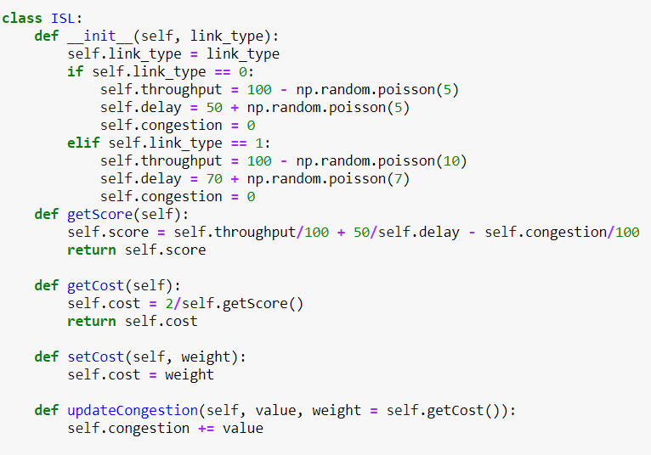
ISL cost for QoS

Slide 44
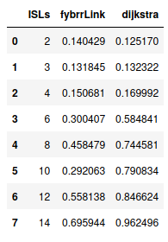
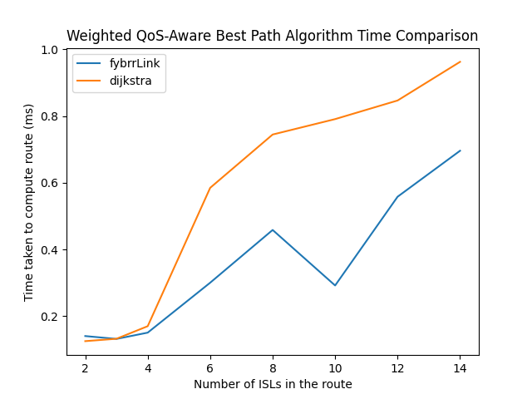
Complexity Analysis

Slide 45
Modified bresenham algorithm
where every integer point is having 8 degrees of freedom
but we developed a modified bresenham algorithm which will work fine with 6 degrees of freedom (2 intra-plane links and 4 inter-plane diagonal links) too.
We derived the bresenham once again with our own requirements to get this modified version

Slide 46
Conversion of satellite coordinates to 2d coordinates
Position of a satellite generally refers to its longitude, latitude, elevation angle, height etc.
but we mapped this to simpler x,y coordinates (assuming each satellite is revolving at same height only) for routing purposes.

Slide 47
Graph implementation of satellite network:
As per our system model, satellites were considered as nodes and their links as edges.
We implemented this class and required methods (e.g., getEdgeCost) so that routing algorithms can be performed on this graph topology.
getEdgeCost() : This function was required to assign cost to each link by taking its latency, bandwidth, packet loss etc. factors into the account.

Slide 48
Implementation of the function getIdealParallelogram():
In our routing algorithm, we were reducing the search space of the Dijkstra algorithm by finding a smaller size parallelogram.
Formation of that parallelogram by computing maximum possible diagonal and vertical links and
removal of unnecessary nodes/links from the graph was the goal for this particular function.

